Slide 1
Simulation of the Grand-canonical Ensemble
CHEM-GA 2600 Statistical Mechanics
Pitch Presentation
Yuchen Shi
2025.12.09

Slide 2
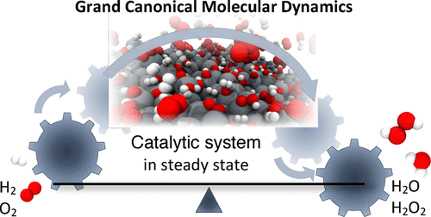
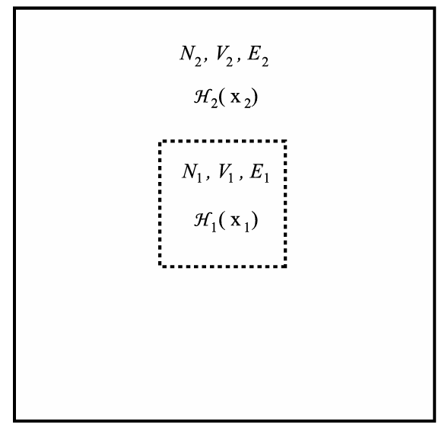
Intro to Grand-canonical Ensemble (GCE)
P A R T 0 1
What is GCE? Why is it hard to simulate?
Why is GCE important?
Lecture 14: (T, V, μ) as control variables with fluctuating energy and number of particles
BUT, discrete particle fluctuations (chemical potential) as control variable, unavailable by standard MD
Model many real-world systems and processes:
Adsorption, electrolytes, ligand-protein binding, phase equilibrium of mixtures…
Fig.1 Demonstration of GCE
(N₂>>N₁)
Tuckerman, Mark E. Statistical mechanics: theory and molecular simulation. (2023)
Fig.2 Example of GCE in Adsorption Catalysis
Jung, Christoph K, et al. Journal of chemical theory and computation (2019)
Notes:
In other ensembles like NVE, NVT, NPT, control variables can be expressed as averages of continuous functions of some phase-space estimators and under control (thermostats, barostats) when evolving the trajectory in phase-space.
Figure 1: Two systems in contact with a common thermal reservoir at temperature T. The dashed lines indicate that systems 1 and 2 can exchange particles. System 2 acts as a particle reservoir.
Why not directly simulate a large enough canonical ensemble, as shown in Fig.1, straightforwardly? Because (1) it can only be applied in spatially homogeneous systems, (2) difficult convergence of particle-number fluctuations, (3) the system is very large
Another example: electrolyte
Local environment near electrode is not neutral and number of particles fluctuates a lot
NVT/NPT simulations must neutralize the systems >> otherwise mess up electrostatics under PBC conditions

Slide 3
Monte-Carlo Method
P A R T 0 2
Monte Carlo
Monte-Carlo Sampling of GCE
Idea:
Repeat random sampling on specific probability distribution to obtain numerical results
Limitation:
Large number of samples to achieve high accuracy (computationally expensive)
Idea:
Sample particle configurations
Sample number of particles with trial particle insertion and deletion controlled by chemical potential
Limitation:
Unachievable in dense fluid systems
Convergence difficulty and high computational cost
Adams, D. J. Molecular Physics 28.5 (1974)

Slide 4
Monte-Carlo Method
P A R T 0 2
Idea of Monte Carlo
Monte-Carlo Sampling of GCE
Idea:
Sample particle configurations
Sample number of particles with trial particle insertion and deletion controlled by chemical potential
Limitation:
Unachievable in dense fluid systems
Convergence difficulty and high computational cost
Fig.3 Example of MC to Calculate Pi
Adams, D. J. Molecular Physics 28.5 (1974)

Slide 5
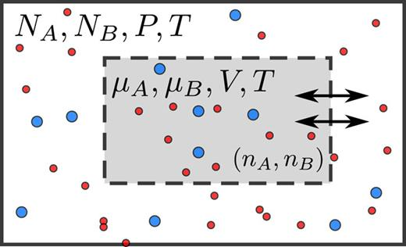
Molecular Dynamics Method
P A R T 0 3
S0 Method: bypass GCE with NPT ensemble
Idea:
“Free lunch” from well-developed NPT simulations
Use the static structural factor from NPT trajectories to capture long-range particle correlations and density fluctuations
Limitation:
Require a large size of simulation system
Can only get the derivative of chemical potential and need a reference to get absolute value
Fig.4 Illustration of NPT and μVT Ensemble
Cheng, Bingqing. The Journal of Chemical Physics (2022).

Slide 6
Conclusion
P A R T 0 3
Two roads diverged in a yellow wood…
More accurate and efficient methods of Monte Carlo and Molecular Dynamics based simulations of the Grand-canonical Ensemble in the future
Applications in battery design, drug discovery, material engineering…

Slide 7
Reference
P A R T 0 4
Adams, D. J. "Chemical potential of hard-sphere fluids by Monte Carlo methods." Molecular Physics 28.5 (1974): 1241-1252.
Cheng, Bingqing. "Computing chemical potentials of solutions from structure factors." The Journal of Chemical Physics 157.12 (2022).
Jung, Christoph K., Laura Braunwarth, and Timo Jacob. "Grand canonical ReaxFF molecular dynamics simulations for catalytic reactions." Journal of chemical theory and computation 15.11 (2019): 5810-5816.
Tuckerman, Mark E. Statistical mechanics: theory and molecular simulation. Oxford university press, 2023.

Slide 8
Q&A
P A R T 0 1

Slide 9
Backup Slides

Slide 10
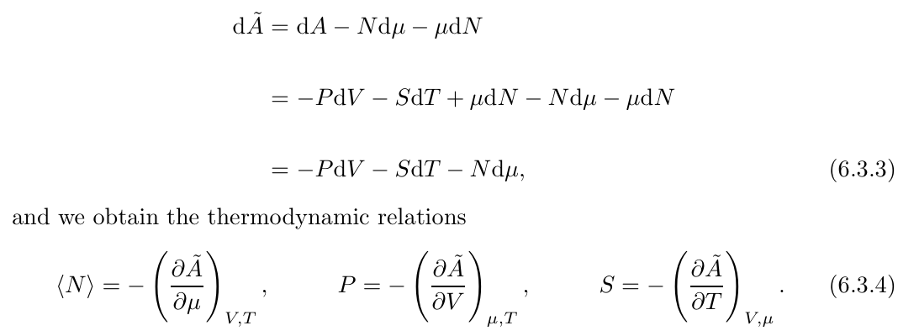
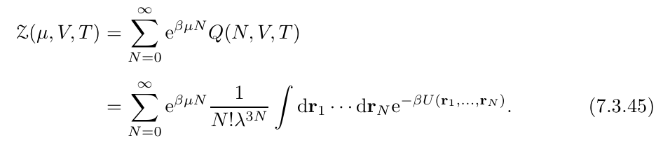
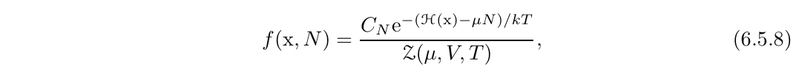
More on GCE…
BACKUP
Some Critical Formulas of Grand Canonical Ensemble
Thermodynamics
Partition function
Phase-space distribution

Slide 11
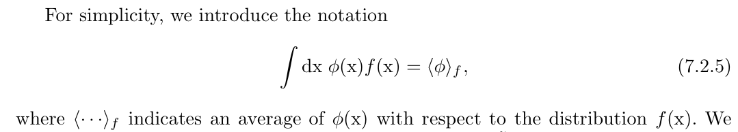
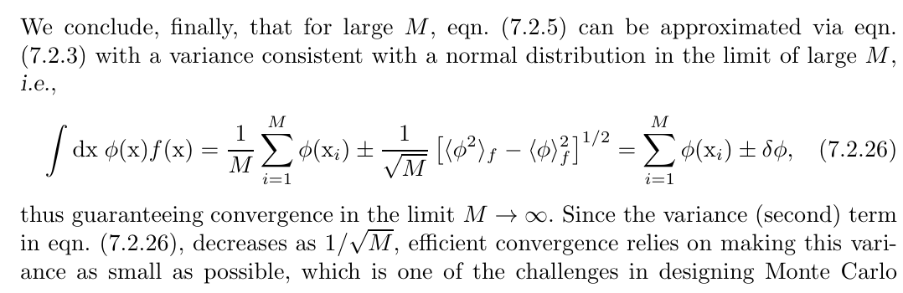
Central Limit Theorem
BACKUP
Theoretical Basis of Monte-Carlo Simulation

Slide 12
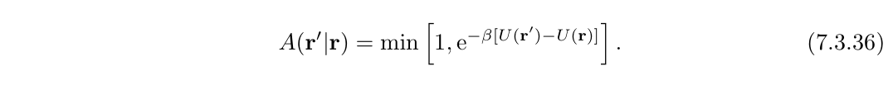
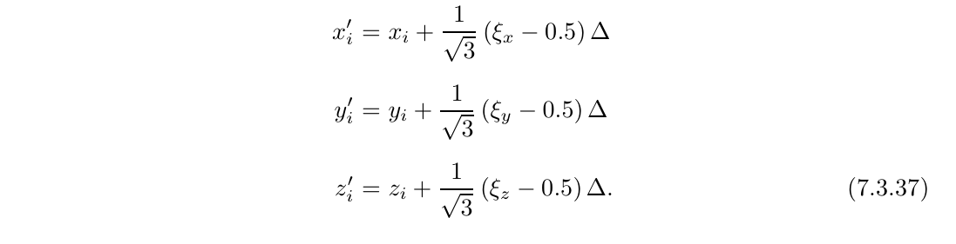
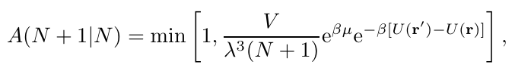
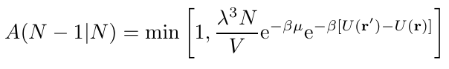
Monte-Carlo Grand Canonical (MCGC)
BACKUP
More about the MCGC and M(RT)^2 Algorithm
Use Markov Chain to sample the configuration space without bias, attempting random moves and accepting them with a probability
Accept the random walks of coordinates & particle change according to the probability based on the potential energy change

Slide 13
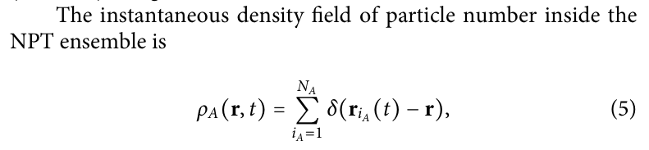
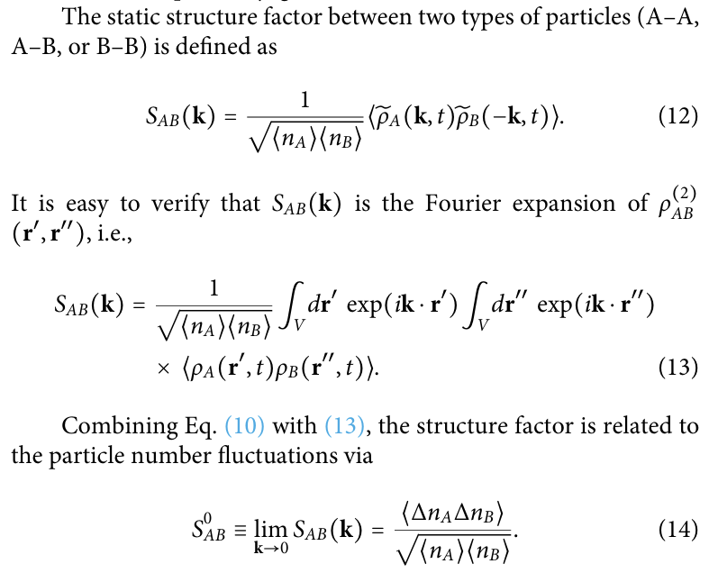
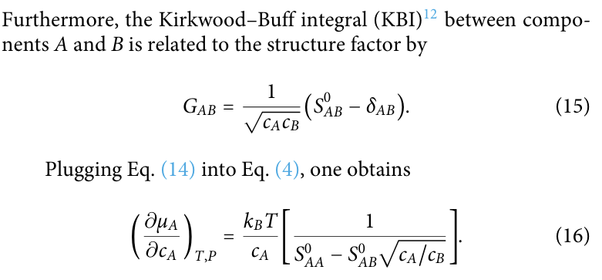
S0 Method
BACKUP
More about the S0 Method

Slide 14
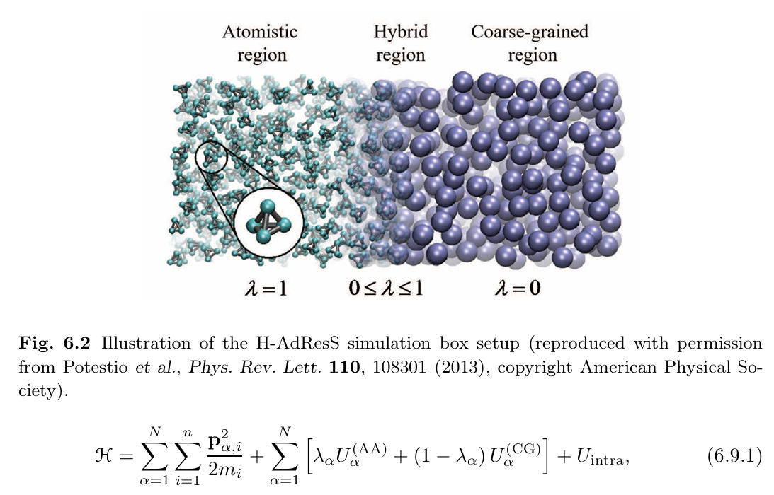
Hamiltonian Adaptive Resolution Simulation (H-AdResS)
BACKUP
Potestio, Raffaello, et al. Physical review letters (2013)
Alternative MD-based Method for GCE

